Slide 1
Azure Arc-enabled data services
Bring cloud data management to any infrastructure
Name
Date

Slide 2
Today’s data realities
3
What data do I have?
Data governance
Where is it located?
2
Can people access the data needed to make the real-time decisions?
Analytics
1
How can I enable faster business insights?
Operational Databases
Operational databases
What’s my compliance exposure?
Notes:
…And doing this isn’t easy, given the realities of data today. The volume, variety and velocity of data are all accelerating dramatically, and the complexity of creating of an enterprise ‘knowledge graph’ can seem insurmountable. Today we generate data far faster than we are able to understand it
In fact, IDC predicts that by 2025, just 5 years from now, the world’s data will climb to 175 zettabytes. Currently, 76% of public cloud adopters are using multiple cloud service providers (CSP), and 96% of organizations are using or evaluating Kubernetes.
Without the right people, processes and capabilities in place, it can be difficult to answer fundamental questions.
What data do I have?
Where is it located?
Are people getting the data they need to make real-time decisions?
Are they getting it fast enough?
And are we managing data in a compliant way?...

Slide 3
Introducing Microsoft Intelligent Data Platform
2
Transform with the Microsoft Cloud
Microsoft Cloud
Dynamics 365 • Microsoft 365 Power Platform
3
Data governance
2
Analytics
1
Accelerate innovation
Achieve agility
Build on a trusted platform
Operational databases
2
Microsoft Intelligent Data Platform
SQL Server • Azure SQL • Azure Cosmos DB • Azure Synapse Analytics
Power BI • Microsoft Purview • Azure AI
Notes:
Getting the right answers to these questions is possible when all your data assets are connected and managed in a cohesive fashion. This is why we announced the Microsoft Intelligent Data Platform, the leading cloud data platform that empowers organizations to invest more time creating value rather than integrating and managing their data estate.
The platform is made up of capabilities across databases, analytics and governance that, on their own, meet specific business needs and already bring many benefits but together helps easily evolve applications to include advanced analytics and intelligence. It is the integration of the products you are already using today to accelerate innovation and achieve agility, across our cloud, as well as others
We want to remove key points of friction between your databases and analytics systems while ensuring your full data estate can be automatically mapped and governed
Organizations can analyze large volumes of operational data in near real-time with no extraction, transformation, or loading (ETL) pipelines, and no performance impact on transactional workloads
And anyone in the organization, whether they’re a data scientist, data analyst or a domain expert, can access, analyze, and share data
This is the state we are all aiming for is where we can:
Accelerate innovation, Focus on what matters most – your business. Free resources to create frictionless customer experiences, transform products and empower employees.
Achieve agility, Pivot faster to respond to dynamic environments with an integrated data platform that adapts to your needs with hybrid and multi cloud capabilities. Build how you want, deploy where you want and gain fast, continuous insights.
Build on a trusted platform, Deliver data-powered experiences with the security and privacy controls required to innovate with confidence. Azure provides the most comprehensive protection for your valuable business data.

Slide 4
Reasons for a hybrid
and multicloud strategy
Regulatory and data sovereignty
Low latency and edge workloads
Application and datacenter modernization
Business continuity and resilience
Freedom to use more than one public cloud
Notes:
Through our experience working with customers, there are a few key reasons for a hybrid and multicloud strategy:
Some workloads cannot be moved to the public cloud due to regulatory and data sovereignty requirements. This is common in highly regulated industries such as financial services, healthcare, and government.
Some workloads, especially edge workloads, require low latency.
And many companies have significant on-premises investments that they want to maximize so they choose to modernize on-premises datacenters and traditional apps.
Finally, it’s important to have the freedom to use more than one public cloud.

Slide 5





Hybrid scenarios for data and apps​ with Azure Arc
Extending and migrating existing apps
Drivers: Existing investments, compliance
Building new cloud native apps
Drivers: Digital transformation, latency
Cloud automation, always up-to-date for on-premises databases
Database-as-a-Service with cloud billing for on‑premises databases
Security and governance across on-premises and multi-cloud
Consistent, portable databases on Kubernetes
Compute, real-time insights when data is created
Notes:
We are seeing customers adopting Azure Arc across a wide spectrum of scenarios for their app and data management.
Some customers want to modernize existing applications in place in their own datacenters while others want to build new cloud native applications and extend or run them outside the cloud.
U.S plumbing supply giant, Ferguson, is using Azure Arc to extend Azure data services to its on-premises datacenters. Specifically, they migrated from SQL Server to Azure Arc-enabled SQL Managed Instance so they are always on the latest version of Azure SQL just like inside of Azure. They never have to worry about when a given SQL Server version might go out of support again.
Royal Bank of Canada is the largest bank in Canada and they also have the largest deployment of SQL Server in the country. They recently adopted Azure Arc-enabled SQL Managed Instance to get Database-as-a-Service benefits like cloud billing and built-in high availability for their on-premises databases supporting the next generation of financial services apps for their customers.
We also have KPMG, a global professional services firm with thousands of clients across the globe each with their own data governance needs. They use Azure Arc to manage, track, and govern databases in their own datacenters, in their customers’ datacenters and in public clouds around the world in a consistent way and from a single point of control - Azure. Because of the services they provide, which includes auditing, tax, and accounting, they need to remain compliant in whatever country they operate in, and the hybrid solution from Azure Arc helps them flexibly deliver their services wherever customers need them.
Koc Systems is the Systems Integrator arm of the Koc Holdings conglomerate in Turkey. Turkish companies must now comply with new data sovereignty laws requiring the PII data of Turkish citizens to be stored in-country. Koc Systems uses Azure Arc to deliver the power of Azure app and data services hosted in datacenters in Turkey to meet these requirements and yet realize all the benefits of Azure data services
And lastly, we have SKF, a Swedish manufacturer, that recently underwent a complete transformation to create a digital manufacturing factory using Azure Arc. They embraced the full Azure hybrid solution by running Arc-enabled SQL Managed Instance on top of Azure Kubernetes Service on Azure Stack HCI to deliver a “cloud-orchestrated, locally-executed” operations model in their 97 factories across the globe. This model drove considerable efficiencies and cost savings for SKF, enabling “data-driven manufacturing” at the edge.

Slide 6


RBC
Azure Arc-enabled data services give us the ability to do a lot right out of the box-the policy enforcement, the visibility, and the health monitoring of resources. From a security standpoint, that’s where we’ve seen the biggest value for us”
Khaled Zaky
Director of Product Management
RBC
Notes:
Royal Bank of Canada speeds innovation on-premises with DBaaS based on Azure Arc-enabled data services.
Situation: Canada’s largest bank, RBC, takes a rigorous approach to technology. A mix of public cloud, private cloud, and on-premises resources allows the bank to offer innovative digital experiences. But the bank wanted a new way to think about its data landscape.
Solution: Azure Arc–enabled data services are powering a faster app pipeline and helping RBC to deliver on a long-desired IT promise—onpremises DBaaS, shaving weeks to months off the engineering teams’ delivery schedules.
Impact: RBC application teams are already taking full advantage of Azure Arc–enabled data services, which open the doors to automated provisioning and management through IaC. It takes teams less time to add and manage infrastructure, and the pay-as-you-go billing model lets them clearly manage usage and costs in a way they couldn’t before.
Read more here: https://customers.microsoft.com/en-us/story/1431733508110961747-royal-bank-canada-speeds-innovation-on-premises-dbaas-based-azure-arc-enabled-data-services

Slide 7
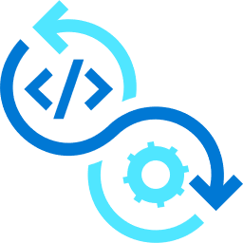


Azure Arc-enabled data services
Bring cloud data management to any infrastructure
Supports all connectivity modes
Always up to date
Multi-layer security
Elastic scale
Simplified DevOps
Automated updates
No downtime, evergreen
Comprehensive encryption
Azure RBAC & Policy
Scale up and down
Pay for what you use
Deploy in seconds
Built in HA/DR
Any infrastructure
Notes:
With Azure Arc-enabled data services, we bring the best of Azure with its cloud data management capabilities, to any infrastructure, no matter where that infrastructure lives. This could be to your existing on-premises environment, in other public clouds, and even at the edge, like we’ve seen with our retail and manufacturing customers. These services can run anywhere, and bring a much needed streamlined experience across your data workloads. Here’s how:
1. Azure Arc-enabled data services will deliver an “always up to date” experience. End of support can be a thing of the past, you can benefit from an evergreen SQL environment with the newest features and automated updates without downtime to maximize efficiencies and minimize disruptions
2. Get industry-leading, multi-layered protection with built-in security. With comprehensive encryption including transparent database encryption and Always Encrypted, as well as Azure role based access control and policy, your data is protected by powerful on-premises and Azure security capabilities.
3. Optimize the performance of your applications by scale up and down based on your application need, no downtime required. Realize cost efficiencies by paying for only what you use and eliminate licenses that are often based on peak expected usage.
4. With Azure Arc, your teams can leverage the tools they are already familiar with. That consistency means a vastly simplified Dev/Ops experience by reducing overhead. Deploy a 3 replica SQL MI with full HA in 2 minutes with a single click, compared to hours. Gain a unified view into your query performance, storage capacity and error logs using dashboards directly from the built-in monitoring.
And all these features are fully supported, even without direct and continuous connection to Azure. So, from the core of your data center to the middle of anywhere you’ll have what you need to keep your database workloads running.

Slide 8

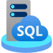

Azure hybrid data destinations
IaaS
PaaS
Azure Arc-enabled
SQL Server
Azure Arc-enabled SQL Managed Instance
Azure Arc-enabled PostgreSQL
Organize, inventory
Enhanced security with Microsoft Defender for Cloud
Free SQL Assessment service
Azure SQL Managed Instance
on any infrastructure
Fully automated, evergreen SQL
Cloud billing model for on-premises
Azure Database for PostgreSQL
on any infrastructure
Fully automated, single server
Scale up/down/out/in
GENERALLY AVAILABLE
GENERALLY AVAILABLE
PUBLIC PREVIEW
Notes:
Arc-enabled SQL Server connect existing SQL Server runs on any physical servers or VMs to Azure. Customers can modernize in place and get searchable inventory lists, enhanced security from MS Defender, and can run SQL assessment for free.
Arc-enabled SQL MI and Postgres both run on any K8s. Arc-enabled SQL MI has near 100% compatibility with the latest SQL Server database engine, and enables existing SQL Server customers to lift and shift their applications to Azure Arc data services with minimal application and database changes while maintaining data sovereignty. It includes built-in management capabilities that drastically reduce management overhead.
Arc Postgres: similar capabilities with Arc SQL MI, as another option for OSS

Slide 9
Savings from Azure Arc-enabled data services
Cost efficiency from automation and better resource use
Flexible cost structures
Choose between allocating costs as Opex or Capex
Lower TCO
Reduce costs with built-in capabilities and increase productivity from automation at scale
Reusable investments
Leverage existing infrastructure, environments and SQL Server licenses

Slide 10


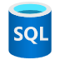


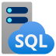


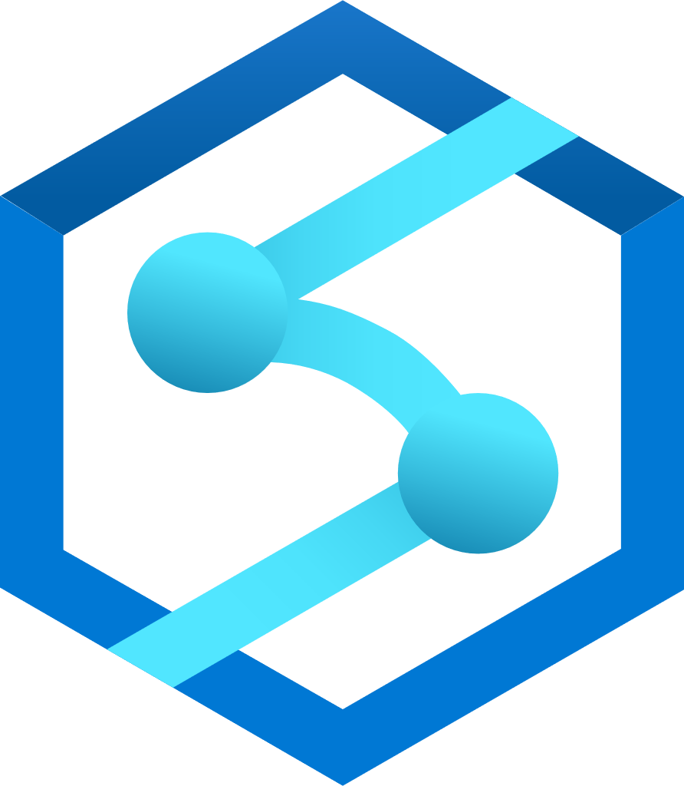
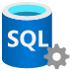
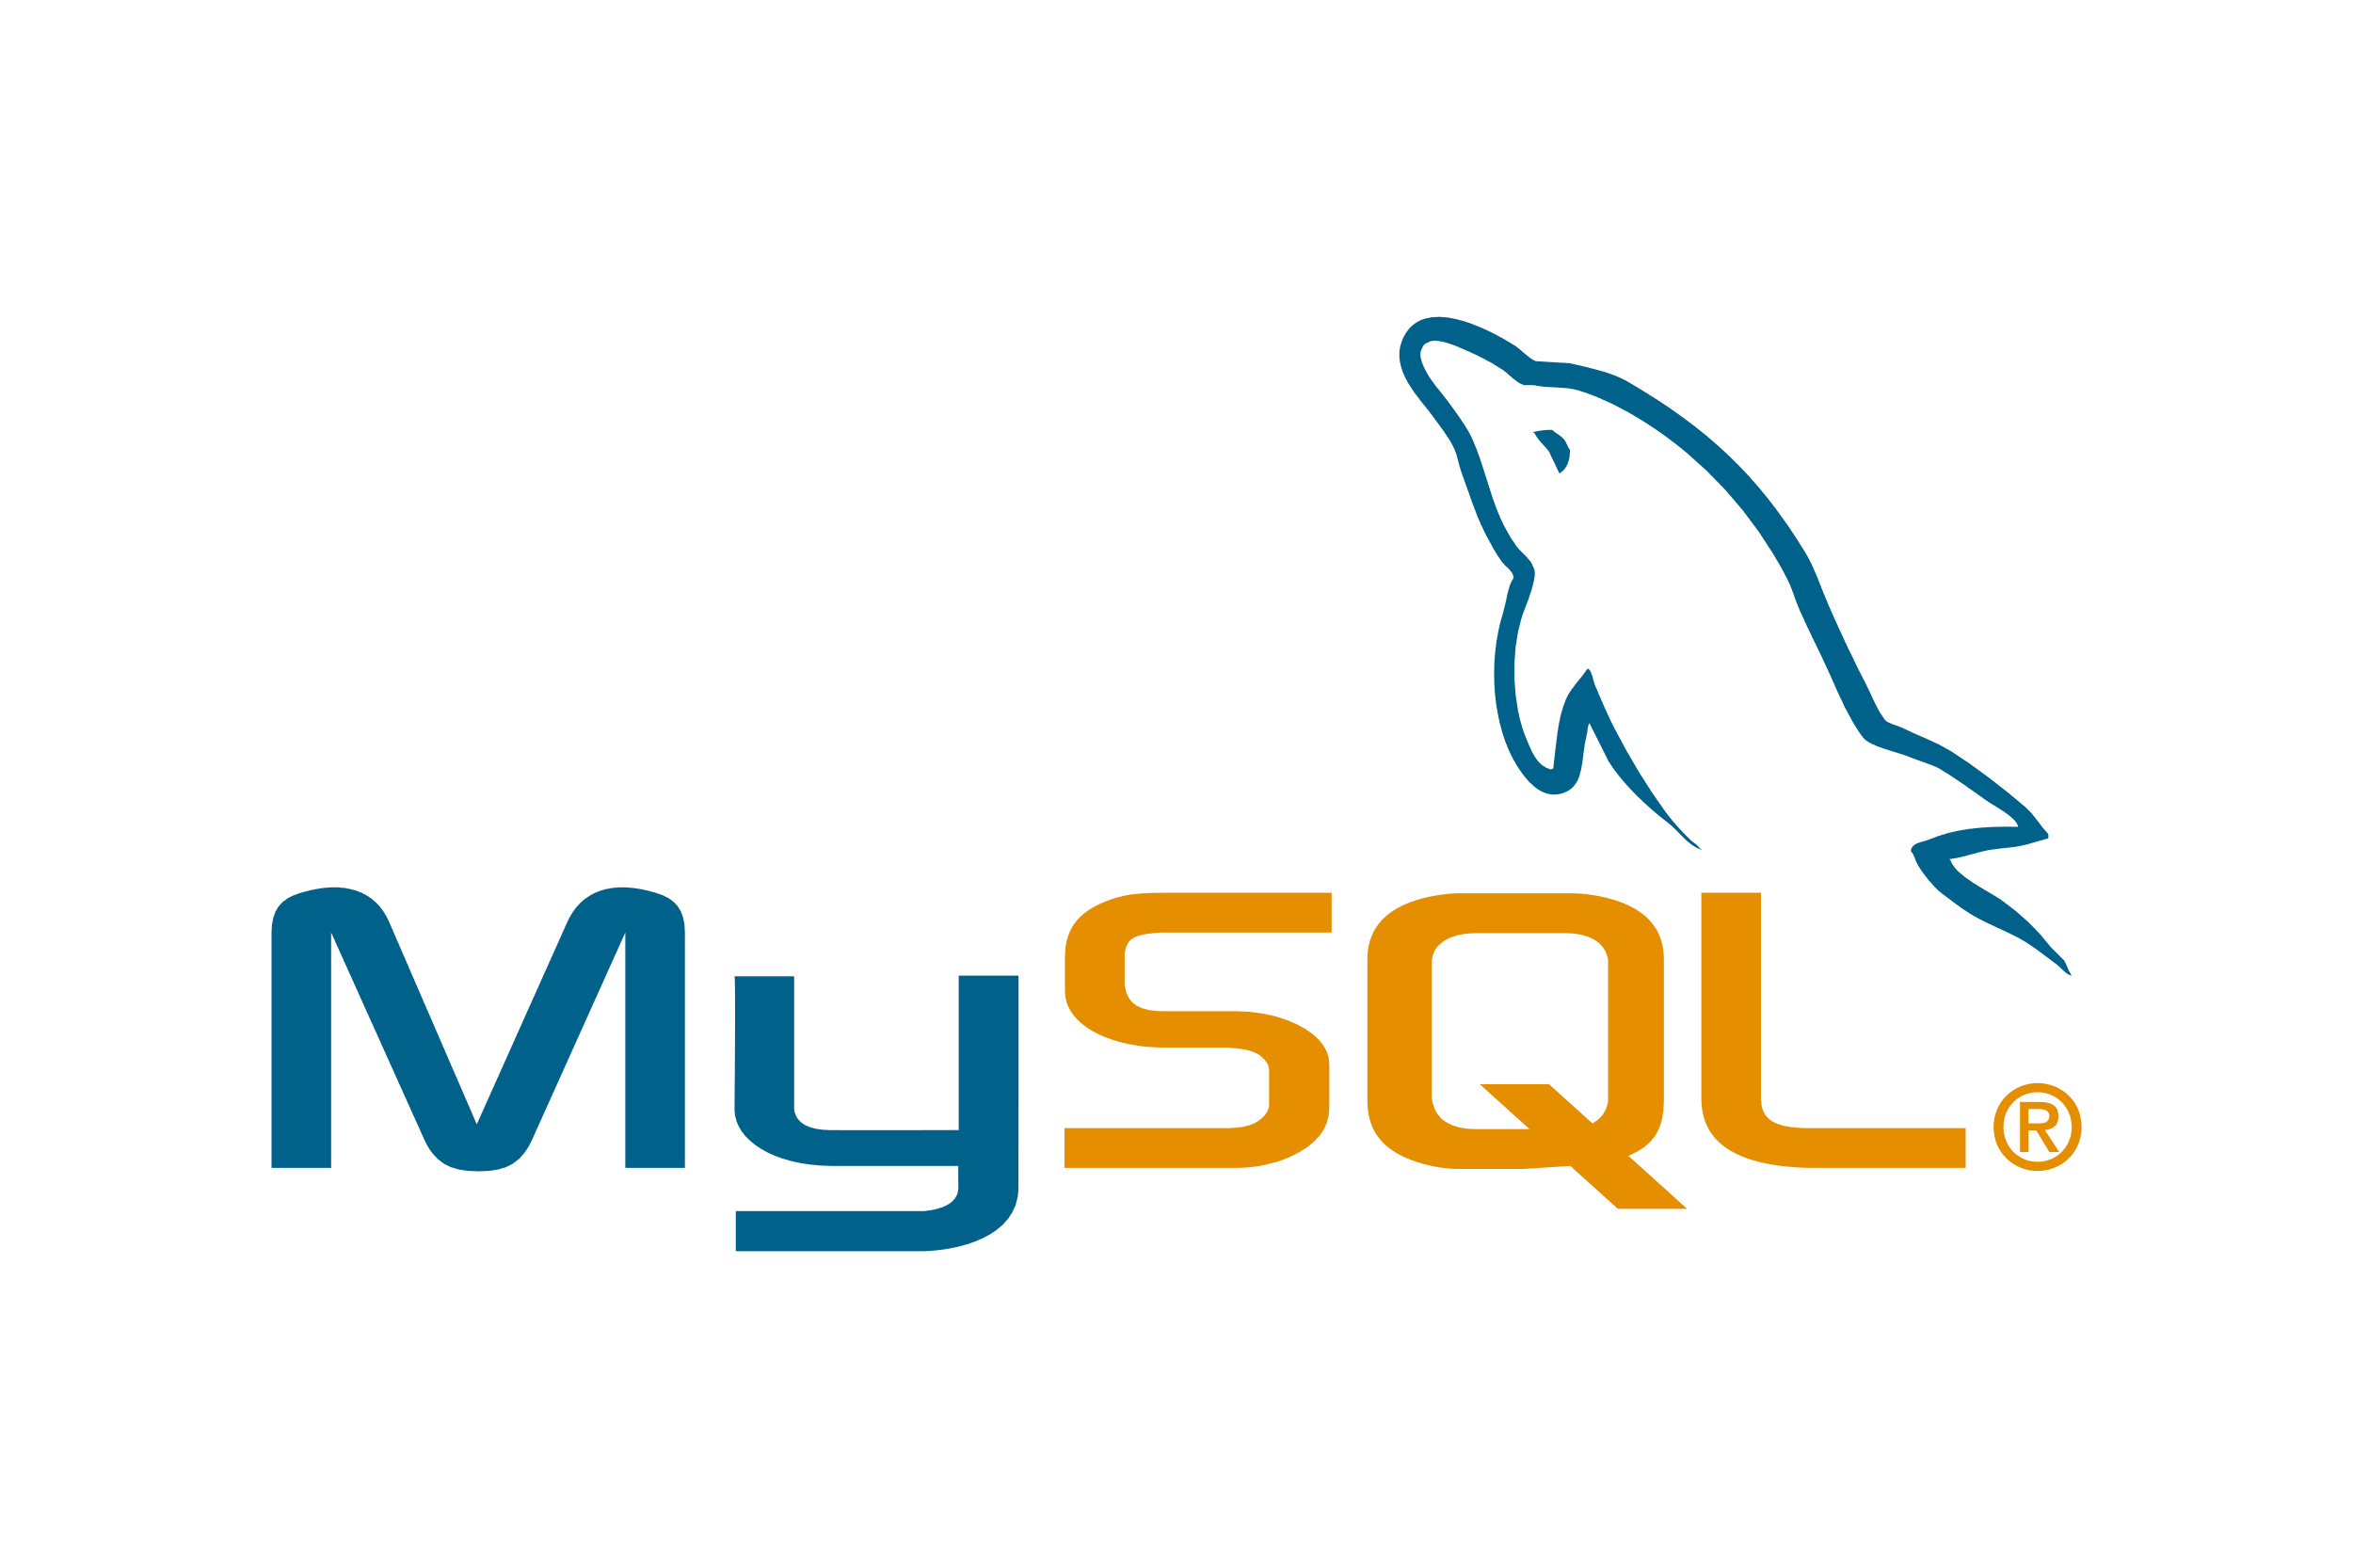

Migrate and modernize your data estate
Azure
IaaS
PaaS
Extend
SQL Server on Azure Virtual Machines
Azure SQL Managed Instance
Azure SQL Database
Azure Database for MySQL
Azure Database for PostgreSQL
Power BI
Azure ML
Azure Synapse Analytics
Azure Arc
SQL Server
MySQL and PostgreSQL
Notes:
In Azure, we’ve put a premium on making it easy to secure and govern servers, applications, and databases with powerful management and security and management services. We have built a flexible and open platform where you can use familiar dev tools, like Visual Studio and GitHub when building the next generation of applications. We also offer a wide range of first-party services from Microsoft - application, data, AI, and ML services, so you can innovate anywhere.
With Azure Arc, we’re creating a bridge between Azure and your other environments - on-premises, multicloud and edge, to bring you all these great innovations.
And we’re doing it in a way where you can confidently invest in a single set of skills and processes that you can transfer wherever they’re needed.
A top of mind concern among our customers has been keeping their Windows Server and SQL workloads running and recoverable in the case of unforeseen events or disasters. Azure provides built-in solutions for customers to implement simple, secure and cost-effective Business Continuity and Disaster Recovery (BCDR) strategies for their applications and data – whether their workloads remain on-premises or have migrated to the cloud.
The reason that we are able to offer hybrid azure solutions that bring the cloud from on-prem to the edge is the level of consistency of our app, data, identity, and security and management offerings across on-prem and cloud. The fact that you are running the same WS and SQL server in the cloud and on-prem makes it easy to migrate and means you can use your existing IT skills.

Slide 11



Innovate anywhere
Security, operations, and governance
Tools and experiences
Azure services
Azure Arc-enabled services
Apps, data, AI
Azure Arc
Cloud infrastructure
Azure Arc enabled infrastructure + devices
Cloud regions
Regional edge
IT edge
IoT edge
50+ Azure regions
Multicloud
Operator DC
Co-Lo provider
Customer DC
Branch office
Factory floor
Retail store
Field production
Notes:
And it’s not only about data. We wanted to bring the value cloud operations and architecture to any infrastructure, which makes your cloud to edge ecosystem simple, flexible, and secure. This is why we built Azure Arc.
Azure Arc is a bridge that extends the Azure platform so you can build applications and services with the flexibility to run across datacenters, edge, and multicloud environments.
Azure Arc provides a consistent development, operations, and security model for both new and existing applications. You use the same tools, the same security and governance technologies to create and manage application resources.
Just like in our datacenters, a subset of Azure services for application, data, and AI are there to use on both new and existing hardware, virtualization, and Kubernetes platforms, IoT devices, and integrated systems.
We’re committed to enabling companies to grow and transform themselves through technology, paving the way for rapid innovation through applications and cost savings across their businesses – independent of who built or owns the facilities and hardware.
Our goal is to simplify the complexity you face when building the applications and services you use to run your business across cloud and edge. We do this by standardizing the way applications are built, deployed and managed, with a common set of tools and experiences. You can be confident investing in Azure knowing that if your regulations change, competition changes, whether you’re using existing or new infrastructure changes, whatever the reason, you can scale and extend your investments to wherever they are needed.
As we work with customers, we see a wide range of ways they want to architect their applications as well as places where they want to run applications, each with their own unique characteristics and requirements.
For some customers the issue is scale, they might need the hyper scale of our Azure regions. Other customers may have latency requirements for workloads that have to run in a factory floor. Others might need to meet data sovereignty needs through their existing datacenters.
That’s why we’re working to bring the Azure platform to all of those places in a way that can meet a broad ranges of requirements, and infrastructure for those applications to run on.

Slide 12


Get empowered by Azure Arc-enabled data services today
Get started
Try Business Critical tier of Arc‑enabled SQL MI : aka.ms/ArcTrial
Learn more
Azure Arc
Innovate Anywhere
Documentation: aka.ms/ArcDataDocs
MS Learn: aka.ms/ArcDataLearn
Arc Jumpstart: aka.ms/ArcJumpstart

Slide 13
Appendix
© Copyright Microsoft Corporation. All rights reserved.

Slide 14
Arc-enabled data services business model comparison
Azure Arc-enabled SQL Managed Instance
Azure Arc-enabled SQL Server* (pay-as-you-go)
Azure SQL
Azure add-on services**
Azure add-on services**
Azure add-on services**
SQL license
SQL license
SQL license
Azure SQL manageability
Azure SQL manageability (PaaS)
Azure SQL manageability (IaaS free)
Not provided by MSFT
Azure control plane (free)
Azure control plane via Azure Arc (free)
Azure control plane via Azure Arc (free)
Free
Additional cost
Azure infrastructure
Customer provided infrastructure
Customer provided infrastructure
Charged in the SKU
Azure/Arc SQL SKU
* SQL Server purchased via L+SA can also be Arc-enabled with the same Azure database manageability
** Azure add-on services like MS Defender for Cloud or Azure Monitor is available with additional cost
Notes:
I wanted to share the difference and the consistency of our data offerings.
[Click]I’m sure you all are very familiar with the Azure SQL structure, that we package the cloud infrastructure (compute), Azure control plane, SQL manageability from IaaS to PaaS, and SQL license together in the Azure SQL SKUs; the Azure add-on services like MS Defender for Cloud or Azure Monitor, comes with additional cost.
[Click]When it comes to Arc, it’s the consistent model just like Azure SQL. For Azure Arc-enabled SQL Managed Instance, except the infrastructure is provided by customers which we don’t have any control, we package the same components into the Arc SKU, including Azure control plane through Arc, SQL PaaS manageability, and SQL license. Other Azure services come with additional cost.
[Click]Now we have the new pay-as-you-go for SQL Server, still the same. The package includes Azure control plane and SQL IaaS manageability, as free, so it’s really the SQL license that we are charging for.
[Click]Please note: SQL Server on L+SA can also connect to Arc and have the hybrid capabilities;

Slide 15
New cloud billing model for SQL Server
Better cost efficiency when paying only for what you use
SQL Server pay-as-you-go licensing enabled by Azure Arc (per core per month/hour)
Flexible licensing options
Pricing | Monthly rate | Hourly rate
Standard Edition | $73 | $0.100
Enterprise Edition | $274 | $0.375
Choose from consumption-based licensing and perpetual SQL Server license
Cost efficiency
Pay by the hour for spikes and ad-hoc usage. No need for full upfront investment
Supports hybrid deployment
Consistent purchasing option across on-premise and in 3rd party cloud
Available on SQL Server 2014, 2016, 2017, 2019, and 2022
Notes:
The innovation for SQL Server came not only from the product, but also from its business model. We are bringing a cloud billing model to your SQL Server, so that you can pay for what you use on a consumption-based meter enabled by Azure Arc.
This means
For the first time, SQL Server customers running their workloads outside of Azure will have the flexibility to choose the consumption-based licensing, besides the perpetual SQL Server license.
The PAYG pricing brings down the upfront cost to as low as $0.1 for Standard Edition and $0.375 for Enterprise Edition (per core per hour). So when there are spikes and ad-hoc usage, customers don’t need to pay for full licenses.
This licensing option is available for new SQL servers deployed on premises or in other 3rd party cloud.
All supported SQL Server versions from SS2014 to SS2022 can transact using the new PAYG model enabled by Azure Arc, aka Azure Arc SQL Server connection is a prerequisite.

Slide 16
Consistent cloud billing model with Azure
 |  | Pay-As-You-Go | 1-year Reserved Instance | 3-year Reserved Instance
General Purpose | License included | $153 | $113 | $93
 | Azure Hybrid Benefit* | $80 | $40 | $20
Business Critical | License included | $434 | $354 | $314
 | Azure Hybrid Benefit* | $160 | $80 | $40
Azure Arc-enabled​ SQL Managed Instance​
Pricing based on 1vCore/month.
*Restrictions apply

Slide 17

Royal Bank of Canada
Azure Arc-enabled data services give us the ability to do a lot right out of the box-the policy enforcement, the visibility, and the health monitoring of resources. From a security standpoint, that’s where we’ve seen the biggest value for us”
Khaled Zaky
Director of Product Management
RBC
Notes:
Royal Bank of Canada speeds innovation on-premises with DBaaS based on Azure Arc-enabled data services.
Situation: Canada’s largest bank, RBC, takes a rigorous approach to technology. A mix of public cloud, private cloud, and on-premises resources allows the bank to offer innovative digital experiences. But the bank wanted a new way to think about its data landscape.
Solution: Azure Arc–enabled data services are powering a faster app pipeline and helping RBC to deliver on a long-desired IT promise—onpremises DBaaS, shaving weeks to months off the engineering teams’ delivery schedules.
Impact: RBC application teams are already taking full advantage of Azure Arc–enabled data services, which open the doors to automated provisioning and management through IaC. It takes teams less time to add and manage infrastructure, and the pay-as-you-go billing model lets them clearly manage usage and costs in a way they couldn’t before.
Read more here: https://customers.microsoft.com/en-us/story/1431733508110961747-royal-bank-canada-speeds-innovation-on-premises-dbaas-based-azure-arc-enabled-data-services

Slide 18
Reliable Rotation through Data-Driven Manufacturing
SKF is proud to be at the forefront of the hybrid cloud revolution. Azure Hybrid Cloud Solutions enable us to maximise our efficiency, grow our digital platform for world class manufacturing and empower the SKF Factories of the Future to innovate towards data driven manufacturing."
"Azure Stack HCI, together with Azure Kubernetes Services, Azure Arc-enabled Data Services, and Azure SQL Edge for IoT create SKF a scalable platform across on-premises, cloud and edge – all with single-pane-of-glass while driving costs down.”
Sven Vollbehr
Head of Digital Manufacturing, SKF Group
Notes:
SKF is the world leading manufacturer for rotation tools and services, supporting reliable, efficient, and environmentally sound industrial operations. ​​The company has embarked on a global effort to modernize and transform their 91 worksites so they can bring rapid innovation and cost savings for industrial solutions. SKF chose to partner with Microsoft because Azure hybrid solutions cover the entire technology stack -- from modern infrastructure with Azure Stack HCI, to consistent data management with Azure Arc-enabled SQL Managed Instance, and to edge compute and intelligence with Azure IoT and SQL Edge. By modernizing the entire stack, SKF is able to implement a hybrid topology that drives agility and consistency across cloud and edge and manages costs more efficiently. We are truly excited to be the partner with SKF on their digital transformation journey and we look to bringing more Azure innovation to our customers.

Slide 19


KoçSistem and Opet
With Azure Arc, we can deploy Azure SQL Managed Instance in our own environment for our next generation customer mobile app. This enabled us to not only meet the regulatory requirements on sensitive PII, but also operate and manage databases at scale just like in Azure.
Basar Kavas, Software Solutions Manager
OPET
Azure Arc-enabled data services provides a Database-as-a-Service model for us to better serve our customers like OPET; they now can run data workloads outside of Azure and yet still enjoy all the Azure innovation and cloud benefits.
Evren Dereci, Chief Marketing Officer
KoçSistem

Slide 20


Ferguson
Using Azure Arc-enabled data services, I’m able to deploy multiple databases with the same exact configuration versus having a bunch of different sizes and flavors out there.”
Kristina Melo
SQL Database Administrator
Ferguson
Notes:
Ferguson is the largest wholesale and retail provider of plumbing and waterworks supplies in the United States, with more than 27,000 employees and annual revenues of $15 billion. As a leader in its industry, Ferguson’s IT department is constantly looking for new technologies to drive the business and better serve its associates, customers, vendors, and contractors.
Situation : Ferguson, the largest wholesale distributor of residential and commercial plumbing supplies in the United States, wanted to understand how it could connect its disparate IT landscape and centralize the management of that landscape.
Solution : With Azure Arc-enabled servers, Ferguson can project its on-premises servers into Azure and organize them using tags like they would any other Azure resource. Ferguson is using this feature to plan out future migration projects. Azure Arc also enables Ferguson to apply the same governance policies used to audit its Azure virtual machines to its on-premises machines. Azure Arc also enables Ferguson to apply the same governance policies used to audit its Azure virtual machines to its on-premises machines. Additionally, they are using Azure Arc-enabled SQL Managed Instance to run versionless SQL in their on prem environments, a big need. This helps their senior DBAs save time.
Impact : By binding their Azure and on-premises environments together through policies and tagging, they can create a consistent way to deploy and manage our systems in a disparate environment. That’s important to them as they become leaner as an organization, they still need to effectively manage their IT footprint. Migrating data was a smooth and fast process, and managers didn’t have to go to multiple locations to see the health of the database environment. Ferguson also anticipates that SQL version control and other features will help reduce senior administrators’ time spent upgrading different versions of databases.
https://customers.microsoft.com/en-us/story/844232-ferguson-enterprises-retailers-azure-arc

